Slide 1



BUBBLE SORT VISUALIZER
PROJECT MEMBERS
INBASREE S 23ITR062
JAGATHEESHWARI L 23ITR065
JANISHAA V 23ITR067
“The Best way to predict the future is to invent it”

Slide 2
PROBLEM DESCRIPTION
Sorting Complexity: Sorting algorithms are fundamental in computer science, yet they are often difficult for students and beginners to fully comprehend.
Visualization Gap: The absence of visual tools leaves learners struggling to understand how data elements are compared and sorted during the process.
Educational Need: An interactive visualizer for the Bubble Sort algorithm is essential, providing a clear, step-by-step demonstration to make the learning experience more intuitive and effective for students.

Slide 3
OBJECTIVES
To visually demonstrate and clarify how the bubble sort algorithm works, enhancing understanding and engagement with the sorting process.
3

Slide 4
Software Used
Front-end:
HTML, CSS, Javascrpit
Programming Language :
Python
Visualization Library :
Py-game, flask
Software Tools
1)IDE :
VS Code
4

Slide 5
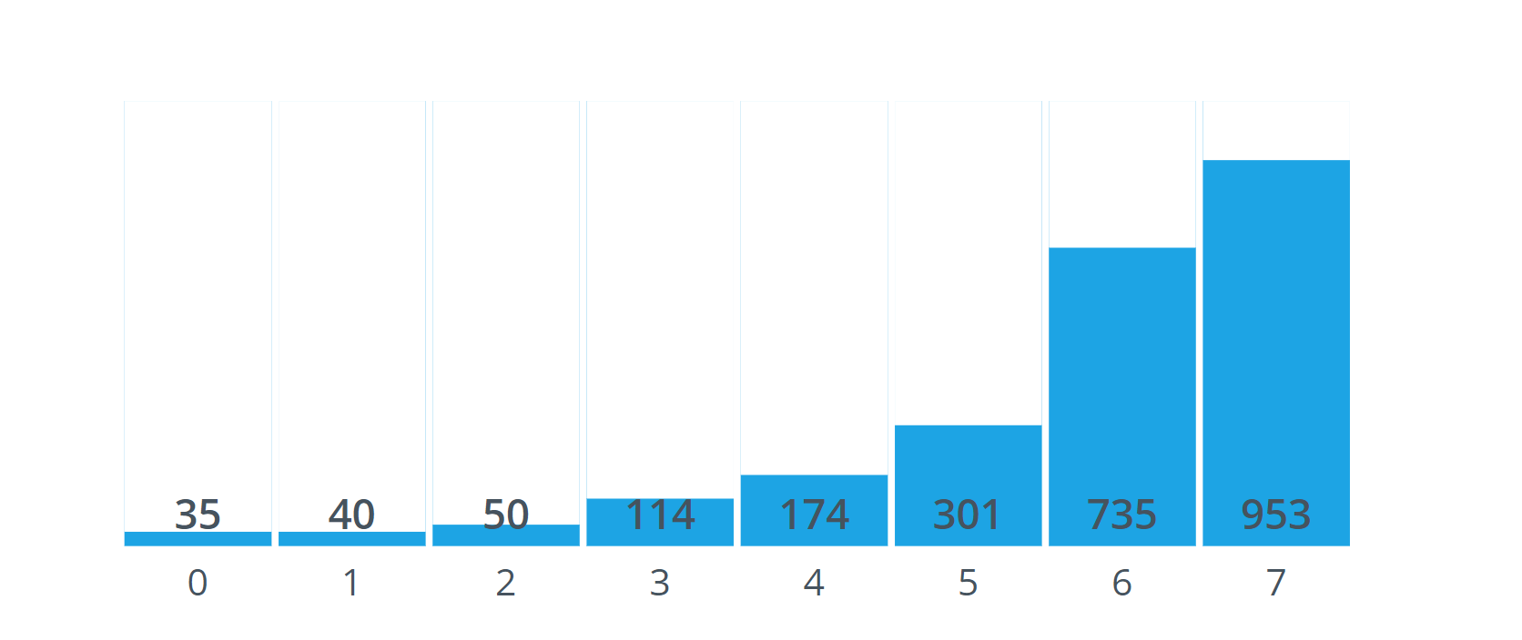
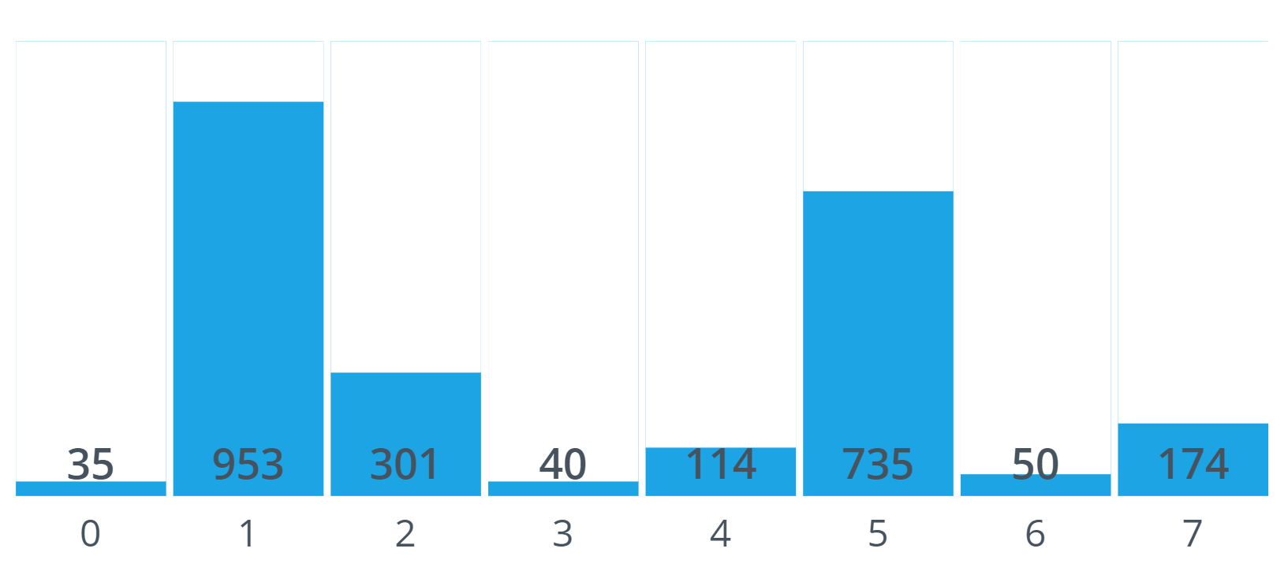
AFTER SORTING
BEFORE SORTING

Slide 6
Process

Slide 7
MODULE – 1 ( DESCRIPTION)
The homepage serves as the main entry point for users. It provides an overview of the sorting visualizer tool, showcasing different sorting algorithms available for visualization. Users can navigate easily to the sorting algorithm pages or log in to access personalized features. Engaging graphics and brief descriptions of each sorting algorithm will help users understand the purpose of the tool.

Slide 8
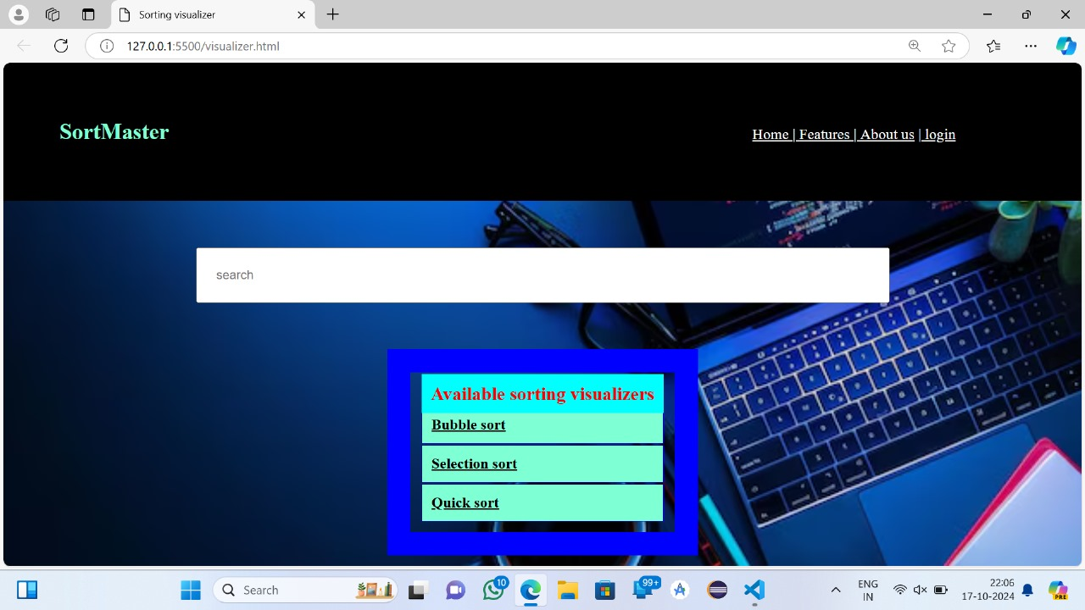
MODULE - 1
Home Page

Slide 9
MODULE -2 ( DESCRIPTION)
The login page allows users to securely access their accounts. It features input fields for username and password, as well as options for password recovery and account creation. A seamless login experience ensures users can quickly access saved visualizations and personalized settings, enhancing their overall experience with the sorting visualizer.

Slide 10
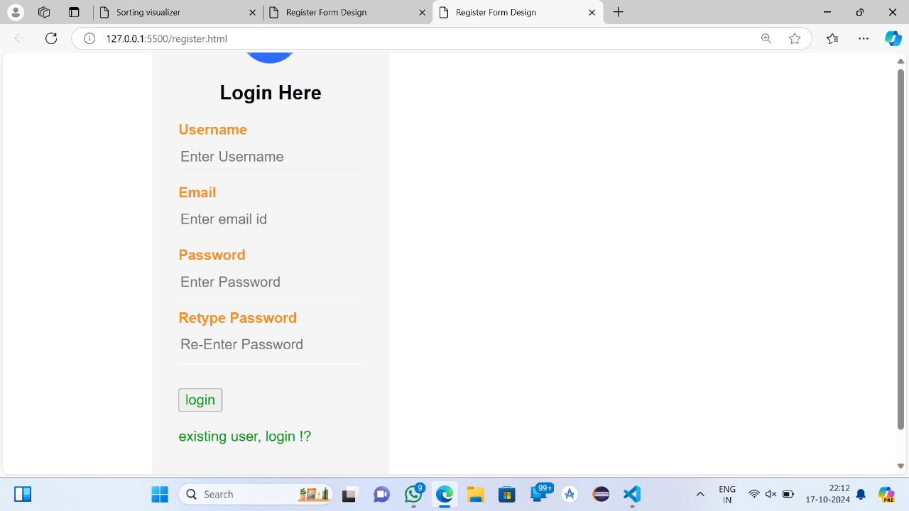
MODULE - 2
Login Page

Slide 11
MODULE – 3 ( DESCRIPTION )
This page provides an interactive visualization of the bubble sort algorithm. Users can input an array of numbers and watch as the algorithm sorts them in real-time. Clear animations illustrate the process, highlighting each comparison and swap, while accompanying text explains the mechanics of bubble sort. Options to adjust speed and reset the visualization enhance user engagement.

Slide 12
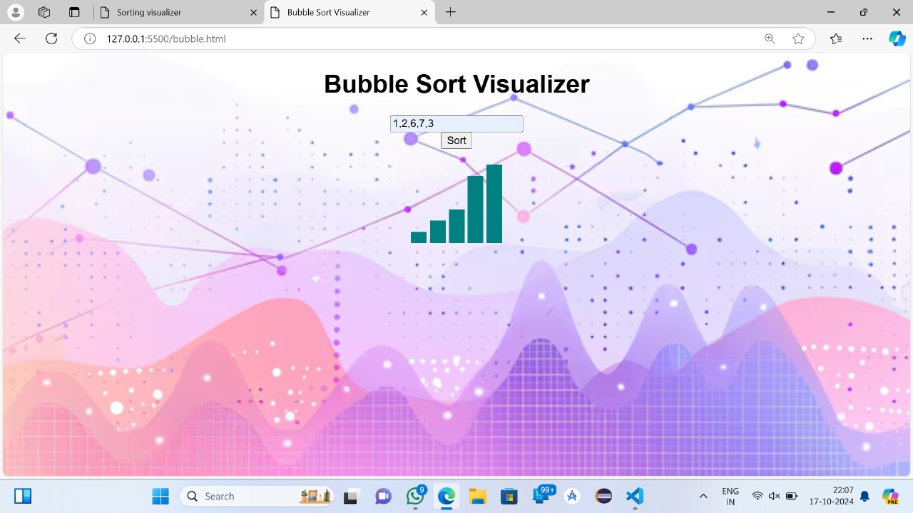
MODULE - 3
Bubble Sort Visualizer

Slide 13
MODULE – 4 ( DESCRIPTION )
The selection sort visualizer page allows users to see how the selection sort algorithm operates step-by-step. Users can input their own arrays, and the visualizer will animate the selection of the minimum element and its placement in the sorted section of the array. Explanatory text will accompany the visualizations, providing insights into the algorithm’s efficiency and process.

Slide 14
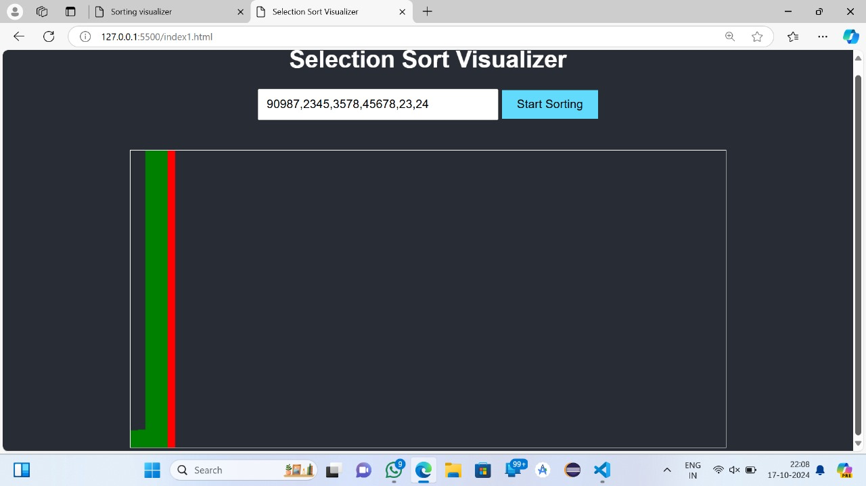
MODULE - 4
Selection Sort

Slide 15
MODULE – 5 ( DESCRIPTION )
On this page, users can explore the quick sort algorithm through an interactive visualization. After inputting an array, users can watch the algorithm divide the array into sub-arrays, demonstrating the pivot selection and partitioning process. The visualizer provides real-time feedback, with detailed explanations of each step, making it easy for users to understand quick sort's divide-and-conquer approach.

Slide 16
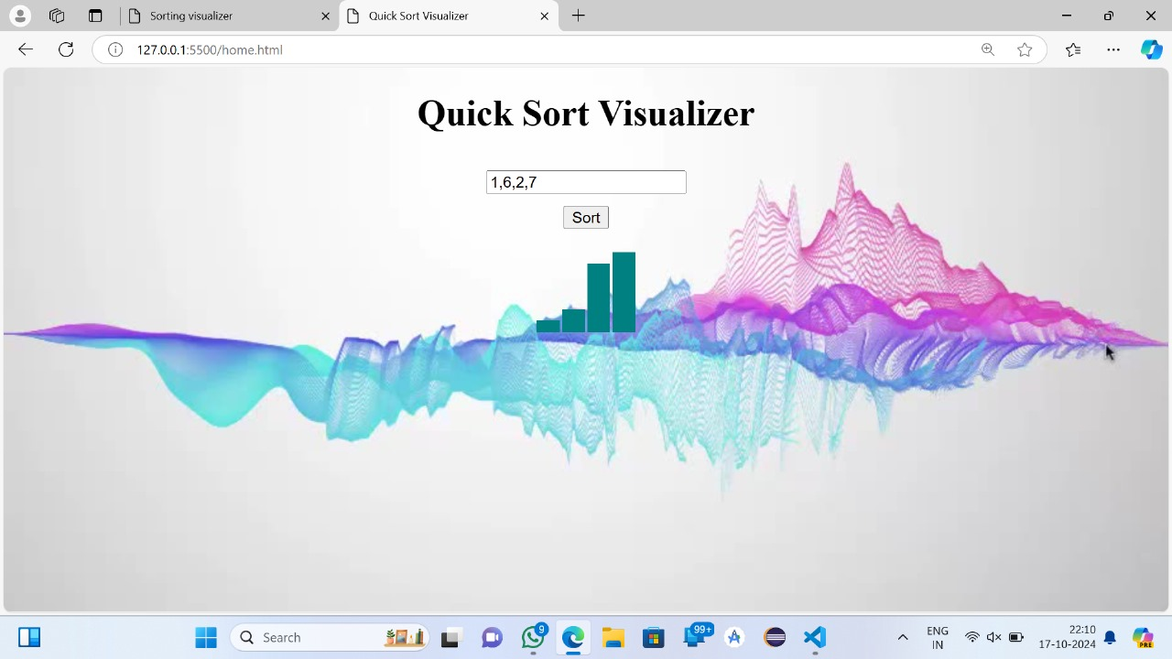
MODULE - 5
Quick Sort

Slide 17
REFERENCE
https://www.geeksforgeeks.org/bubble-sort-visualizer-using-pygame/
https://ijisae.org/index.php/IJISAE/article/view/6645
Sort Visualizerhttps://www.sortvisualizer.comSort Visualizer
https://www.google.com/url?q=https://www.sortvisualizer.com/&sa=U&sqi=2&ved=2ahUKEwjDuuDtlZeJAxXVwjgGHYgSALsQFnoECBYQAQ&usg=AOvVaw2o5Z346_YCl1-XcJBsUeZt
https://visualgo.net/en/sorting
https://ijisae.org/index.php/IJISAE/article/view/6645

Slide 18
Thank you

